Slide 1
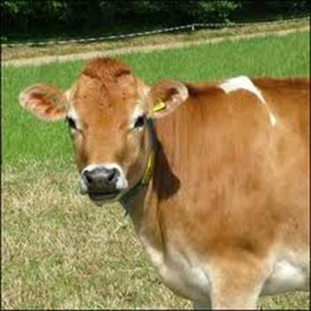
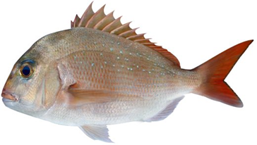
The Australian Food Industry

Slide 2
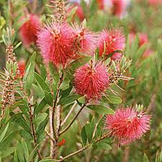
Historical development of the food industry pre-colonisation
The Aboriginal people of Australia ate a wide arrangement of foods ,although much of the food depended on where the tribe were living and what was available in the local area. They moved frequently from place to place in accordance with seasonal availabilities of food resources and to ensure they did not deplete the area of any one species.
Seafood was popular amongst the coastal population
sustainability of food sources was an integral part of food gathering
Hunting was normally done by the men in the tribe

Slide 3
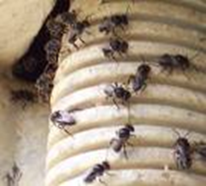
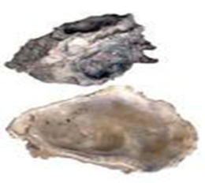
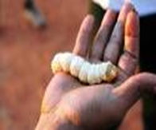
Native Foods
Photo courtesy of
Banksias, grevilleas and melaleucas
Honey
Macadamia Nuts
Oysters
Bugs and grubs
Native Animals
Grass trees
Lilly pillies

Slide 4
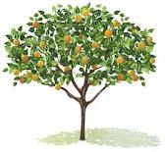
Historical development of the food industry arrival of the First Fleet
Animals were scarce as there was not a huge amount brought over on the ships and many that were brought did not survive the trip the first dairy was opened in 1805 in Ultimo before the dairy opened some officers had house cows.
Early attempts at growing crops in Sydney cove were unsuccessful the rules and principles that had been used in England just did not work here in the Australian Climate.
Establishing fruits ,grains and vegetables were among the highest priority for the colony as the distance to the motherland was just too far for them not to succeed they had no other options the population had to be fed

Slide 5
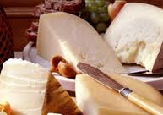
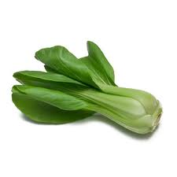
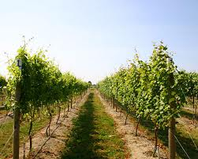
Historical development of the food industry immigration
1830 Germans migrated bringing with them wine
1850’s the Gold rush brought the Chinese, Scandinavians, Greeks and Americans to Australia with many staying in Australia and settling
1880’s large number of Italians immigrated to Melbourne and Sydney they brought fruit and vegetables and ricotta cheese. They predominately worked in timber mills and sugarcane fields in QLD.
1920’s saw a large amount of Americans arrive and with them came the now large corporations Kellogg's and Kraft.

Slide 6
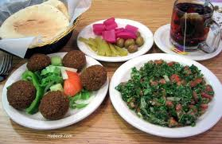
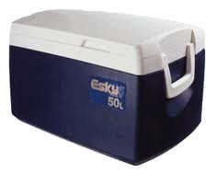
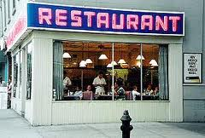
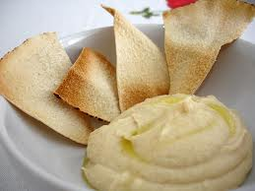
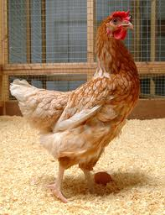
Historical development of the food industry immigration
.
1960’s saw the introduction of the fast food super chains KFC and McDonalds
2000’s sees that the Australian population has a large number of people living here who were born in the UK and NZ
1940’s saw many Lebanese immigrate to Australia where they lived and worked many of them opened food outlets and they introduced the population to Hummus, tabouli and felafels.
1970’s saw a lot of Asian immigrants – Cambodians, Vietnamese, Thai and Korean and with them came a whole new world of ingredience, recipes and cuisine.

Slide 7
Historical development of the food industry in the twentieth century
1900-2000 is referred to as the 20th Century and within this time significant things happened within the food industry
GO TO - http://www.kraft.com.au/Products/KRAFTHistory/HowPeopleLived/HowPeopleLivedBackInTheDays.aspx

Slide 8
Historical development of the food industry in the twentieth century
Decaffeination of Coffee and Tea
Freeze-drying
Online shopping
Canning
Refrigeration
juice concentrates
pasteurization
transportation of delicate perishable foods
24 Hour convenience
Safe food handling
fermentation in the
brewing industry
introduction of artificial sweeteners
Added Iron & folate
Mass production of food
Frozen foods
Delivered to your door
mechanical dehydration

Slide 9
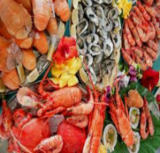
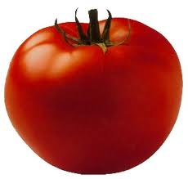
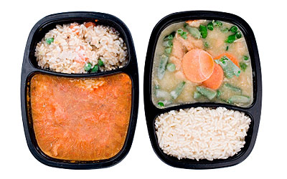
Historical development of the food industry modern Australian Cuisine
Choice & availability
ENERGY DRINKS
Genetically Engineered foods
MOLECULAR GASTRONOMY
MICROWAVE MEALS
ORGANIC FOOD

Slide 10
Factors that influence the Australian food industry nationally
Environmental Factors
Economy
Climate

Slide 11
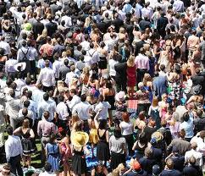
Factors that influence the Australian food industry globally
Photo courtesy of clip art
Global Issues
Tourism
Population & global Demand

Slide 12
The True Cost of Food
Just for FUN watch this video on the true cost of food on the environment, society and individuals.
http://www.youtube.com/watch?v=FDQHYYknTrE&feature=related

Slide 13
The impact of food manufacturing on the individual
Leisure time
Limited skill set
Added nutrients

Slide 14
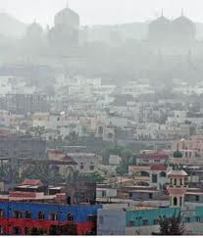
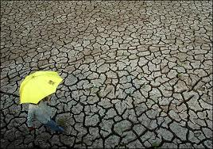
The impact of food manufacturing on society
Water Crisis
Health issues
Land Scarcity

Slide 15
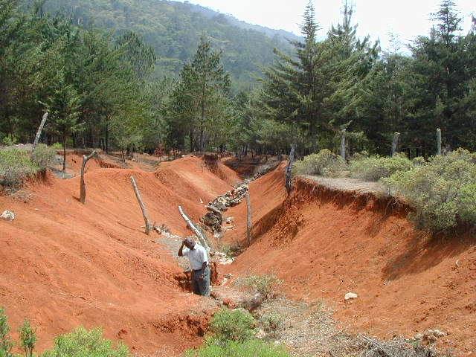
The impact of food manufacturing on the environment
Ocean resource depletion
Nutrient Loss
Energy Use
Climate

Slide 16
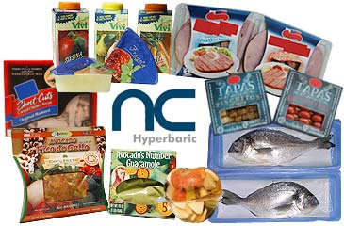
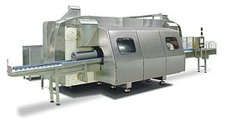
Emerging technology
High pressure processing
Extends shelf life, and does not compromise sensorial and nutritional properties of products. No need for additives and preservatives.
Wide range of HPP processed products: meat products, fruit juices & smoothies, seafood, dairy products and ready-to-eat meals

Slide 17
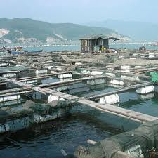
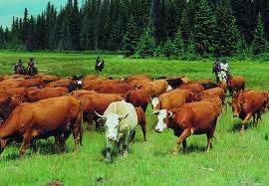
Sustainable production methods
Land Care
Sustainable Practices
Aquaculture

Slide 18
Reference
http://www.enotes.com/australian-aborigines-reference/australian-aborigines
http://hsc.csu.edu.au/agriculture/production/aboriginal_land/aborigl.html
http://www.nationaltrust.com.au/schoolsprogram/educationkits/TFS.pdf
http://www.nationmaster.com/graph/foo_mcd_res-food-mcdonalds-restaurants
http://www.dictionaryofsydney.org/entry/immigration
http://www.kraft.com.au/Products/KRAFTHistory/DecadesOfHistory/1930d.aspx
http://www.redmeatgreenfacts.com.au/Manage-Land/Sustainable-Agriculture
http://hsc.csu.edu.au/food_technology/industry/aquaculture/aquacult.htm
http://www.abc.net.au/schoolstv/food/ep10.htm
http://www.daff.gov.au/fisheries/aquaculture

